Slide 1
PROJECT TITTLE
“BOOK RESALE”
SUBMITTED BY
Mr. Vishal Kailash Aher (Roll No: 2)
Mr. Karan Prakash Bohare (Roll No: 15)
Mr. Sachin Manbahal Chaudhari (Roll No:16)
Mr. Prashant Ganesh Deshmukh (RollNo:28)
GUIDED BY
“Ms. Minal S. Darekar”

Slide 2

DEPARTMENT OF COMPUTER SCIENCE, IT AND ANIMATION
Project Report on
“Book Resale”
Submitted by
Mr. Vishal Kailash Aher (Roll No: 2)
Mr. Karan Prakash Bohare (Roll No: 15)
Mr. Sachin Manbahal Chaudhari (Roll No:16)
Mr. Prashant Ganesh Deshmukh (RollNo:28)
BCA (Sci.) III Year VI Semester Academic
Year 2022-2025
Guided by
“Ms. Minal S. Darekar”

Slide 3
Acknowledgment
Many people have contributed in some or the other forms to this project, although our name appears on the cover of this project. We could not have done this Case Study without the assistance or support of each of the following. We thank all of you.
We wish to place on record our deep sense of gratitude towards our project Ms. Minal S. Darekar and in-charge Dr. Rajashri A. Joshi for the constant motivation and valuable help through the project. We also want to express our gratitude towards our Head of the department Dr. Ritesh A, Magre, for his invaluable guidance, insightful advice and continuous encouragement. We also extend our thanks to other faculty members for their co-operation. We also extend our thanks to other faculty members for their co-operation. We also thank those who have directly as well as indirectly supported us for the completion of this Project.
MR. Vishal K Aher (Roll No: 2)
MR. Karan Bohare (Roll No: 14)
MR. Sachin M Chaudhari (Roll No:16)
MR. Prashant Deshmukh (RollNo:28)

Slide 4
Introduction to Project
The second-hand book resale market has grown significantly as a sustainable and cost-effective way to access knowledge. With the rising costs of education and textbooks, students often struggle to afford new books. Simultaneously, many books go unused or are discarded after a single use, creating waste and missed opportunities for reuse.
This project focuses on creating a platform for second-hand book resale, providing a solution for students and readers to buy books at affordable prices. The platform bridges the gap between sellers, who wish to declutter their shelves, and buyers, who need affordable access to educational or leisure reading materials.

Slide 5
The project aims to promote sustainability by encouraging the reuse of books, reducing paper waste, and fostering a community of book lovers. It leverages technology to simplify the process of listing, searching, and purchasing books, ensuring convenience for users.
By addressing the financial and environmental challenges associated with the traditional book industry, this project contributes to making education and reading more accessible while promoting eco-conscious behavior.

Slide 6
System Analysis
Do you think you can preserve best facility in this center?
Ans: yes
The website is user friendly
Ans: No, it is free of cost for all.
How much Ram is needed for it?
Ans: 500Mb or more.
Which processer can support this processor?
Ans: Core2 duo and all Android phone processor.
Can this project edit by anyone?
Ans: No, only developers can edit it by using their username and password

Slide 7
This project had update regular?
Ans: Yes. It require updating at some time.
If any problem than any support will give you?
Ans.: We will provide all support need to you.
How much data speed required for this project?
Ans: Minimum 100 kbps speed required.
Are all internet browser support this site?
Ans: Yes all browser support.

Slide 8
Scope of System
The purpose of this project is to establish a book resale business, either through physical locations (brick-and-mortar stores) or online platforms (e.g., an e-commerce website, online marketplace). The goal is to create a sustainable, scalable operation for purchasing used books, refurbishing or categorizing them, and reselling them to a variety of customers.
To utilize resources in an efficient manner by increasing their productivity through automation.
The System generates types of information that can be used for various purposes.
Delivered on schedule within the budget.

Slide 9
Hardware & Software Requirements
name of component | Specification
Processor | Ryzen 3, dual core
RAM | 128mb
Hard disk | 20GB
Monitor | LED
Keyboard | 122

Slide 10
Name of the component | Specification
Language | Html, CSS, JAVA script
Database | MYSQL server
Browser | Chrome
Software development kit | Java JDK 1.7 or Above
Operating system | Windows 10

Slide 11
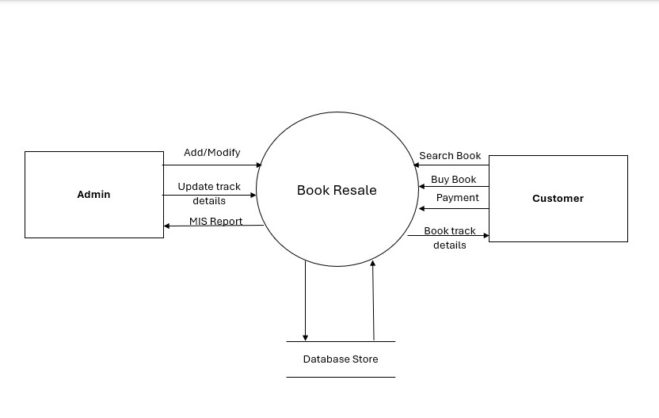
DFD
Zero level diagram

Slide 12
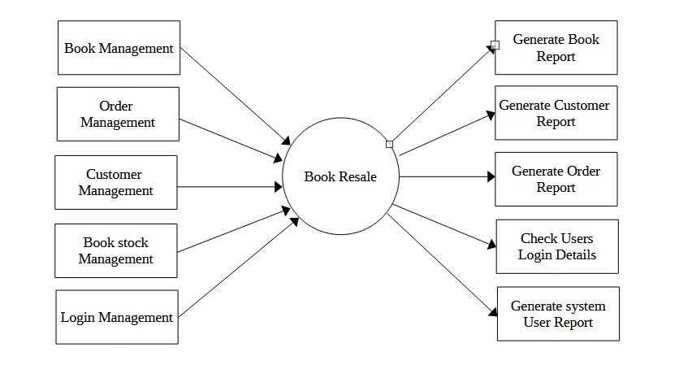
1-Level Data Flow Diagram

Slide 13
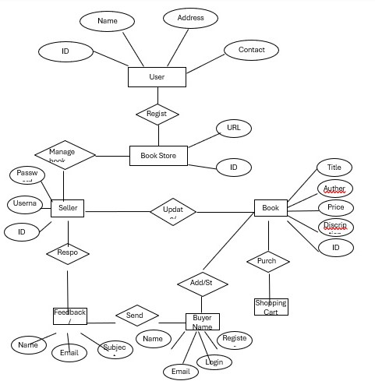
Entity Relationship Diagram

Slide 14
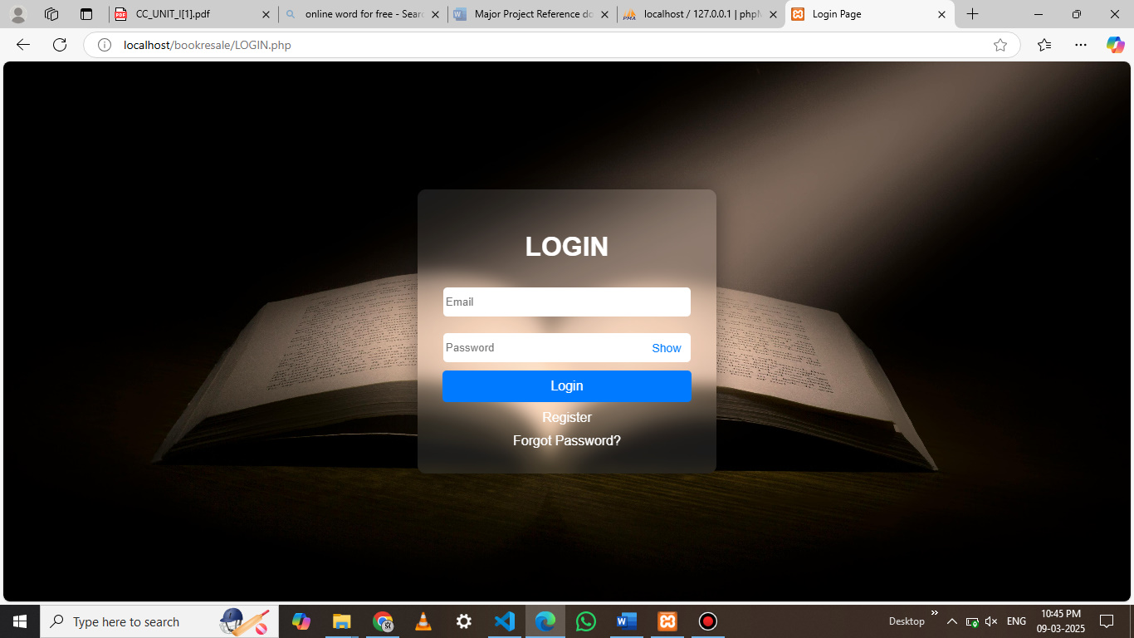
Output Screens
Login Page

Slide 15
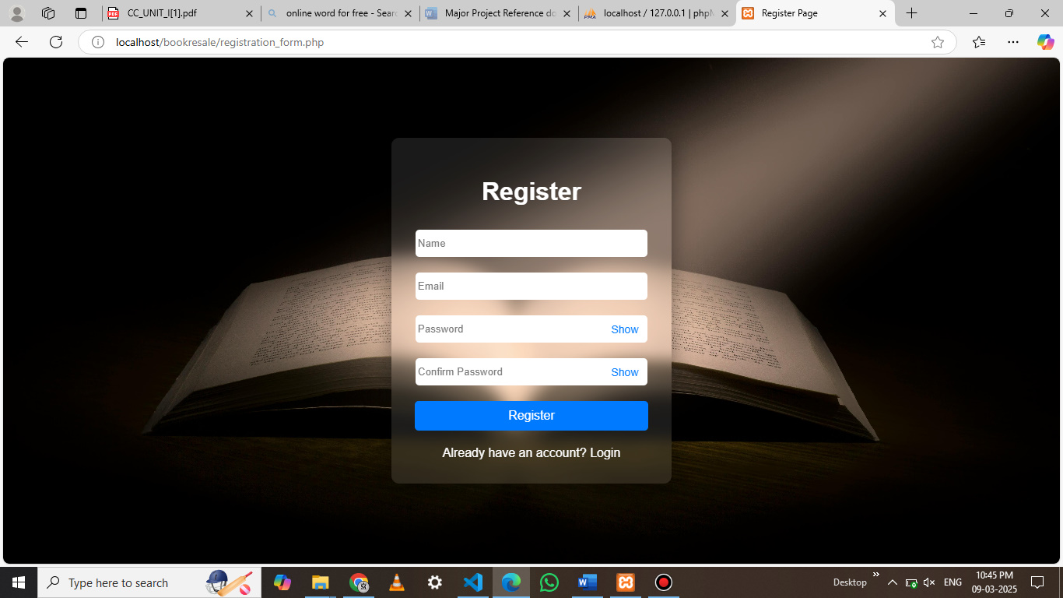
REGISTRATION PAGE

Slide 16
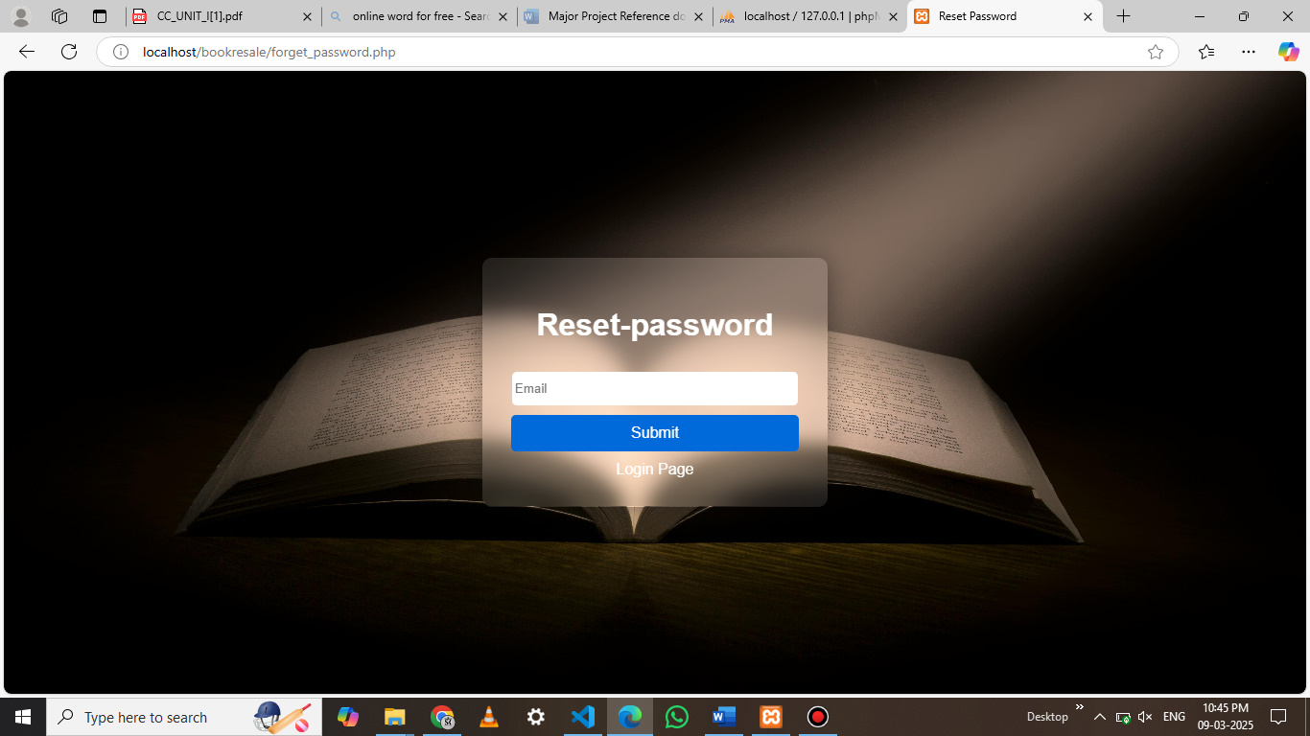
RESET PASSWORD PAGE

Slide 17
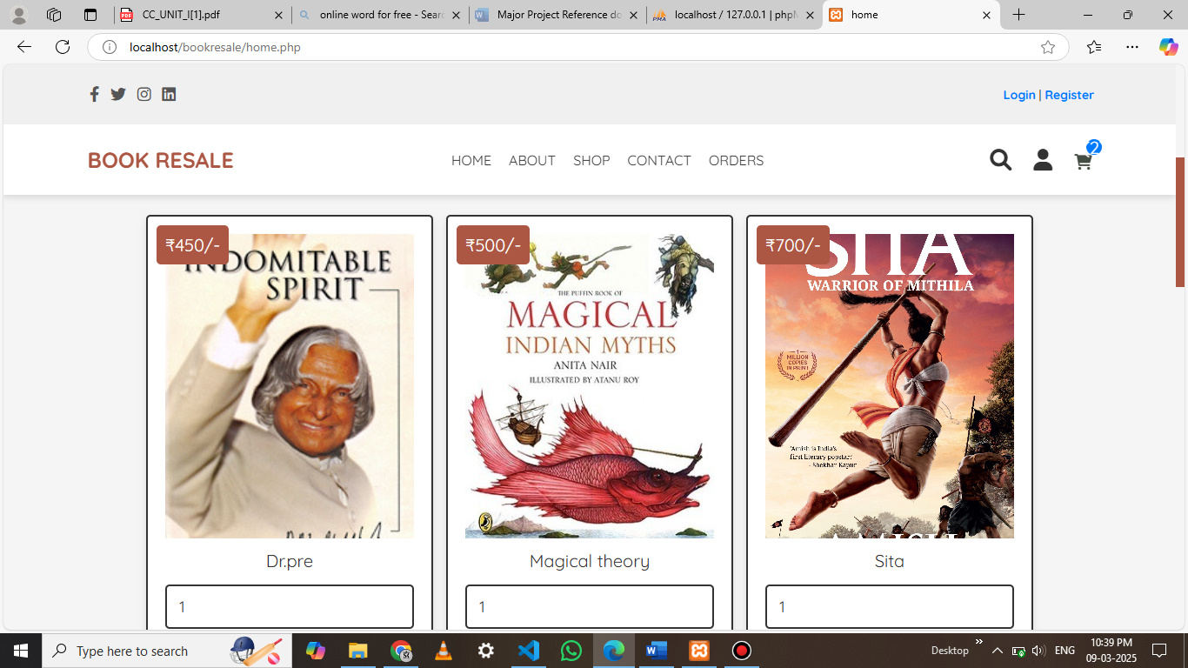
HOME PAGE

Slide 18
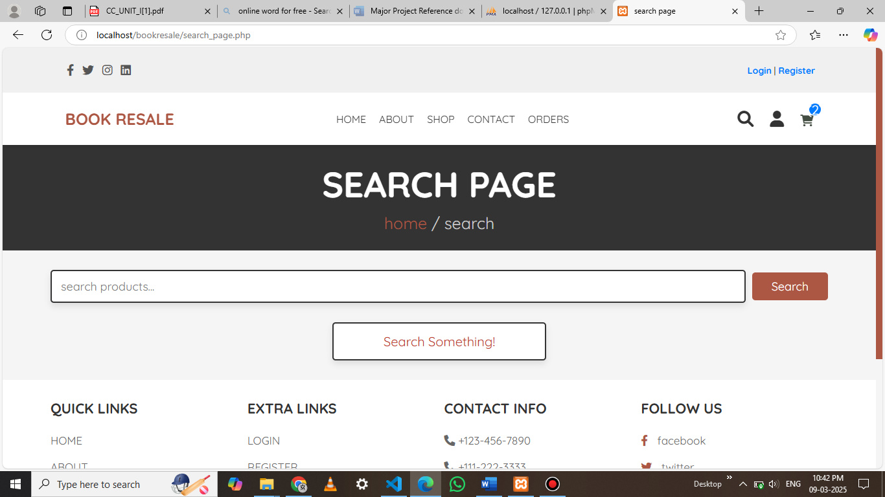
SEARCH PAGE

Slide 19
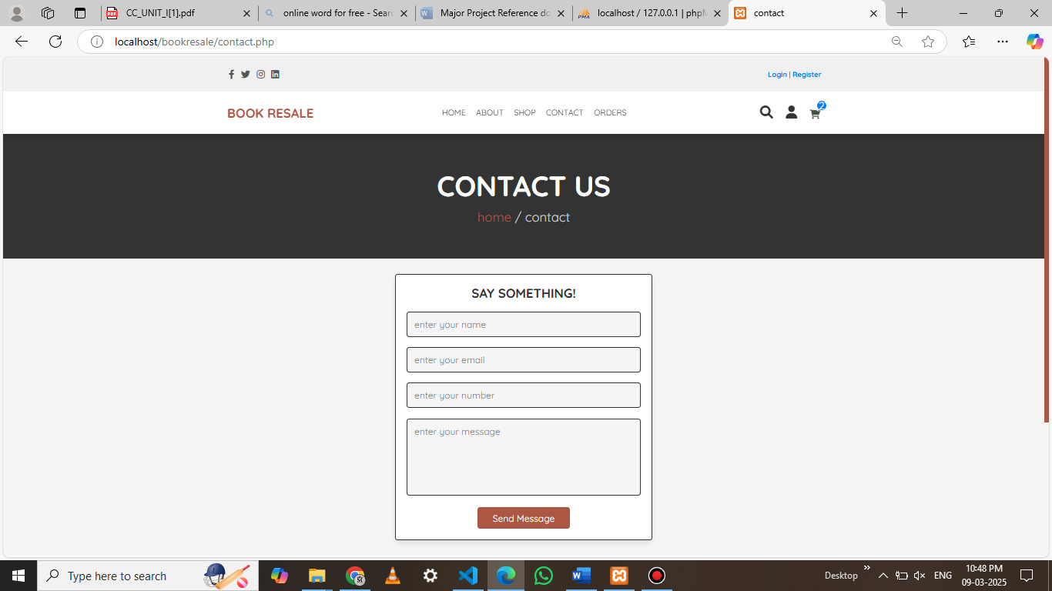
CONTACT PAGE

Slide 20
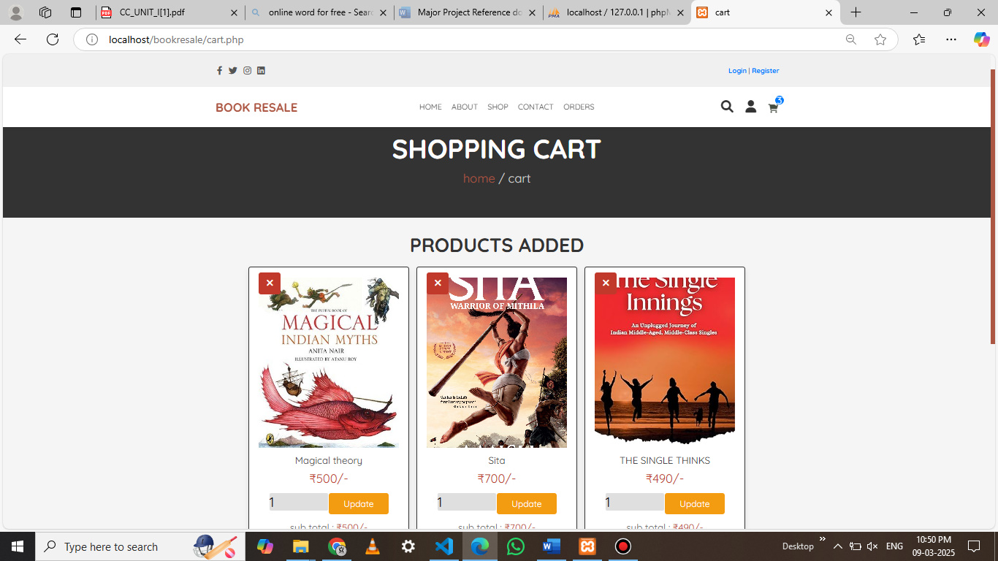
SHOPPING CART

Slide 21
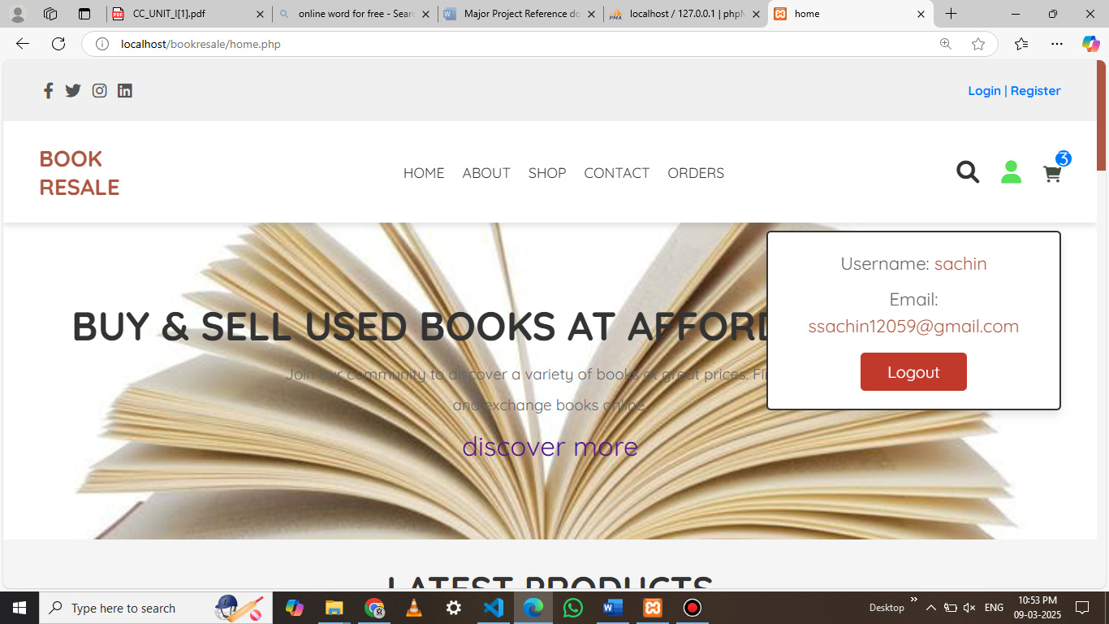
User Profile

Slide 22
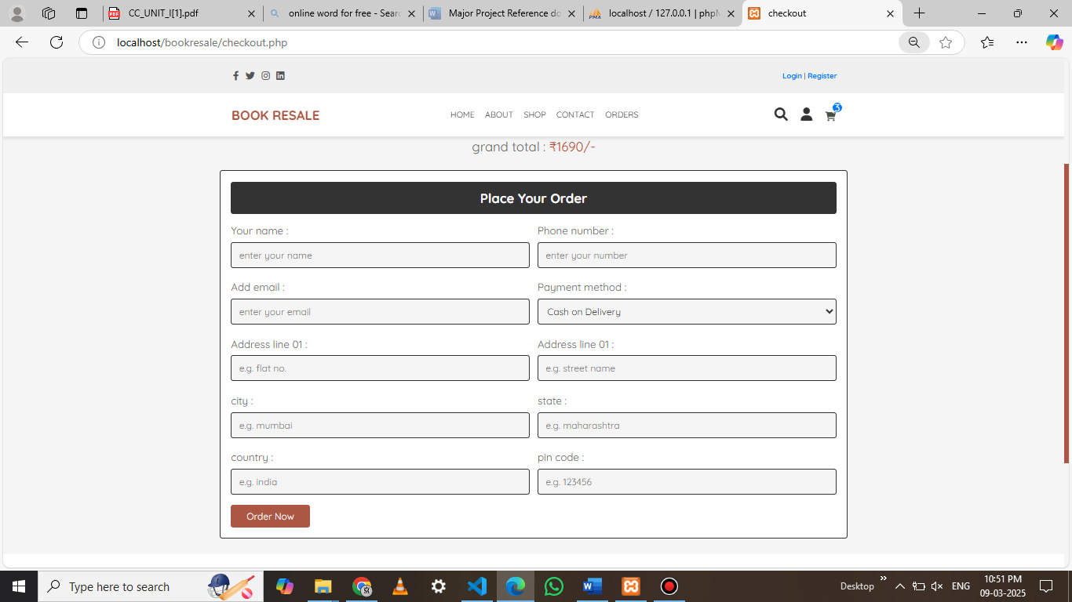
Check Out

Slide 23
Conclusion:
Conclusion: The Book Resale project successfully created a platform that enables users to buy affordable price.
second-hand books with ease. Through the use of web technologies like HTML, CSS, JavaScript, PHP,
and MySQL, the project provided a secure and user-friendly environment for listing books, browsing
options, and managing transactions. The project not only enhanced my web development skills but also
provided valuable insights into the practical aspects of e-commerce and database management.

Slide 24
Bibliography &Web reference
HTML and CSS: Design and Build Websites-By Jon Docket
The Essential Guide to CSS and HTML Web Design (Essentials)-By CraigGrannel
Smashing CSS: Professional Techniques for Modern Layout-By Eric Meyer
The Joy of PHP Programming: A Beginner’s Guide-By Alan Forbes
The Complete Beginner’s Guide to Learn PHP Programming-By Bruce Berke
New Features And Good Practices-By Josh Lockhart
PHP Advanced and Object-Oriented Programming: Visual QuickPro Guide-ByLarry Ulman
SQL Queries for Mere Mortals-By John L. Viescas and Michael J.Hernandez
SQL Performance Tuning-y peter gulutzan
The Art of Sql-By Stephane Faroult
Learn JavaScript VISUALLY-By Ivelin Demirov

Slide 25
Web reference
https://www.w3schools.com
https://www.geeksforgeeks.org
https://www.tutorialspoint.com
https://www.youtube.com
https://www.html-css-js.com
https://www.js-fiddle.net
www.wikipedia.org
www.youtube.com/webdevelopment

Slide 26
Thank You

